Slide 1
Digital Logic Design
Lecture 13

Slide 2
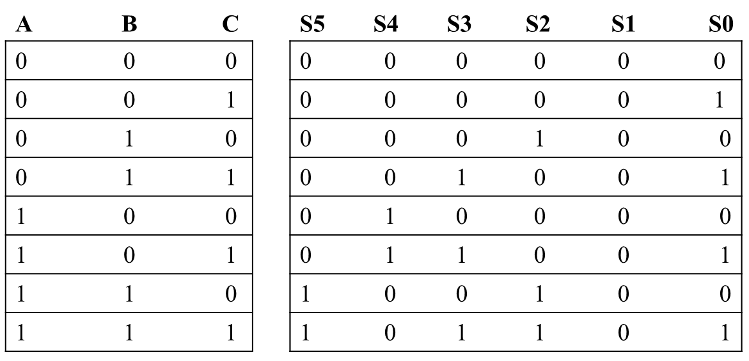
A circuit that generates square of a 3 bit number
1
1 0 0
BC
A
K-map for S0:
0 | 1 | 1 | 0
0 | 1 | 1 | 0
S0 = C

Slide 3
BC
A
K-map for S2:
0 | 0 | 0 | 1
0 | 0 | 0 | 1
S2 = BC’
BC
A
K-map for S3:
0 | 0 | 1 | 0
0 | 1 | 0 | 0
S3 = AB’C + A’BC
BC
A
K-map for S4:
0 | 0 | 0 | 0
1 | 1 | 1 | 0
S4 = AB’ + AC
BC
A
K-map for S5:
0 | 0 | 0 | 0
0 | 0 | 1 | 1
S5 = AB

Slide 4
Analysis Procedure
Boolean Expression Approach
T₂=ABC
T₁=A+B+C
T₃=AB'C'+A'BC'+A'B'C
F’₂=(A’+B’)(A’+C’)(B’+C’)
F₂=AB+AC+BC
F₁=AB'C'+A'BC'+A'B'C+ABC
F₂=AB+AC+BC

Slide 5
Analysis Procedure
Truth Table Approach
= 0
= 0
= 0
= 0
= 0
= 0
= 0
= 0
= 0
= 0
= 0
= 0
A B C | F₁ | F₂
0 0 0
0
0
0
0
0
0
0 0
0
1
0

Slide 6
Analysis Procedure
Truth Table Approach
A B C | F₁ | F₂
0 0 0 | 0 | 0
0 0 1
= 0
= 0
= 1
= 0
= 0
= 1
= 0
= 0
= 0
= 1
= 0
= 1
0
1
0
0
0
1
1 0
1
1
0

Slide 7
Analysis Procedure
Truth Table Approach
A B C | F₁ | F₂
0 0 0 | 0 | 0
0 0 1 | 1 | 0
0 1 0
= 0
= 1
= 0
= 0
= 1
= 0
= 0
= 1
= 0
= 0
= 1
= 0
0
1
0
0
0
1
1 0
1
1
0

Slide 8
Analysis Procedure
Truth Table Approach
A B C | F₁ | F₂
0 0 0 | 0 | 0
0 0 1 | 1 | 0
0 1 0 | 1 | 0
0 1 1
= 0
= 1
= 1
= 0
= 1
= 1
= 0
= 1
= 0
= 1
= 1
= 1
0
1
0
0
1
0
0
0 1
0
1

Slide 9
Analysis Procedure
Truth Table Approach
A B C | F₁ | F₂
0 0 0 | 0 | 0
0 0 1 | 1 | 0
0 1 0 | 1 | 0
0 1 1 | 0 | 1
1 0 0
= 1
= 0
= 0
= 1
= 0
= 0
= 1
= 0
= 1
= 0
= 0
= 0
0
1
0
0
0
1
1
1
1 0
0

Slide 10
Analysis Procedure
Truth Table Approach
A B C | F₁ | F₂
0 0 0 | 0 | 0
0 0 1 | 1 | 0
0 1 0 | 1 | 0
0 1 1 | 0 | 1
1 0 0 | 1 | 0
1 0 1
= 1
= 0
= 1
= 1
= 0
= 1
= 1
= 0
= 1
= 1
= 0
= 1
0
1
0
1
0
0
0
0
0 1
1

Slide 11
Analysis Procedure
Truth Table Approach
A B C | F₁ | F₂
0 0 0 | 0 | 0
0 0 1 | 1 | 0
0 1 0 | 1 | 0
0 1 1 | 0 | 1
1 0 0 | 1 | 0
1 0 1 | 0 | 1
1 1 0
= 1
= 1
= 0
= 1
= 1
= 0
= 1
= 1
= 1
= 0
= 1
= 0
0
1
1
0
0
0
0
0
0 1
1

Slide 12
Analysis Procedure
Truth Table Approach
A B C | F₁ | F₂
0 0 0 | 0 | 0
0 0 1 | 1 | 0
0 1 0 | 1 | 0
0 1 1 | 0 | 1
1 0 0 | 1 | 0
1 0 1 | 0 | 1
1 1 0 | 0 | 1
1 1 1
= 1
= 1
= 1
= 1
= 1
= 1
= 1
= 1
= 1
= 1
= 1
= 1
1
1
1
1
1
1
0
0
1
1 1
 |  |  |  | B
 |  | 0 | 1 | 0 | 1
A |  | 1 | 0 | 1 | 0
 |  |  | C
 |  |  |  | B
 |  | 0 | 0 | 1 | 0
A |  | 0 | 1 | 1 | 1
 |  |  | C
F₁=AB'C'+A'BC'+A'B'C+ABC
F₂=AB+AC+BC

Slide 13
Design Procedure:
Given a problem statement:
Determine the number of inputs and outputs
Derive the truth table
Simplify the Boolean expression for each output
Produce the required circuit
Example:
Design a circuit to convert a “BCD” code to “Excess 3” code
4-bits
0-9 values
?
4-bits
Value+3

Slide 14
BCD-to-Excess 3 Converter
 |  |  |  | C
 |  |  | 1 | 1 | 1 | B
A |  | x | x | x | x
 |  | 1 | 1 | x | x
 |  |  | D
 |  |  |  | C
 |  |  | 1 | 1 | 1
 |  | 1 |  |  |  | B
A |  | x | x | x | x
 |  |  | 1 | x | x
 |  |  | D
A B C D | w x y z
0 0 0 0 | 0 0 1 1
0 0 0 1 | 0 1 0 0
0 0 1 0 | 0 1 0 1
0 0 1 1 | 0 1 1 0
0 1 0 0 | 0 1 1 1
0 1 0 1 | 1 0 0 0
0 1 1 0 | 1 0 0 1
0 1 1 1 | 1 0 1 0
1 0 0 0 | 1 0 1 1
1 0 0 1 | 1 1 0 0
1 0 1 0 | x x x x
1 0 1 1 | x x x x
1 1 0 0 | x x x x
1 1 0 1 | x x x x
1 1 1 0 | x x x x
1 1 1 1 | x x x x
w = A+BC+BD
x = B’C+B’D+BC’D’
 |  |  |  | C
 |  | 1 |  | 1
 |  | 1 |  | 1 |  | B
A |  | x | x | x | x
 |  | 1 |  | x | x
 |  |  | D
 |  |  |  | C
 |  | 1 |  |  | 1
 |  | 1 |  |  | 1 | B
A |  | x | x | x | x
 |  | 1 |  | x | x
 |  |  | D
y = C’D’+CD
z = D’

Slide 15
BCD-to-Excess 3 Converter
A B C D | w x y z
0 0 0 0 | 0 0 1 1
0 0 0 1 | 0 1 0 0
0 0 1 0 | 0 1 0 1
0 0 1 1 | 0 1 1 0
0 1 0 0 | 0 1 1 1
0 1 0 1 | 1 0 0 0
0 1 1 0 | 1 0 0 1
0 1 1 1 | 1 0 1 0
1 0 0 0 | 1 0 1 1
1 0 0 1 | 1 1 0 0
1 0 1 0 | x x x x
1 0 1 1 | x x x x
1 1 0 0 | x x x x
1 1 0 1 | x x x x
1 1 1 0 | x x x x
1 1 1 1 | x x x x
w = A + B(C+D)
y = (C+D)’ + CD
x = B’(C+D) + B(C+D)’
z = D’

Slide 16
Gray to Binary Code
Design a circuit to convert a 3-bit Gray code to a binary code
The formulation gives the truth table on the right
It is obvious from this table that X = C and the Y and Z are more complex
Gray
Binary
A B C
x y z
0
0
0
0
0
0
1 0
0
0
0 1
1
1 0
0 1 0
0 1 0
0 1
1
0 1
1
1 0
0
1
1
1
1 0 1
1 0 1
1
1 0
0
0 1
1
1
1

Slide 17
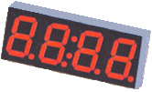
Seven-Segment Decoder
a
w x y z | a b c d e f g
0 0 0 0 | 1 1 1 1 1 1 0
0 0 0 1 | 0 1 1 0 0 0 0
0 0 1 0 | 1 1 0 1 1 0 1
0 0 1 1 | 1 1 1 1 0 0 1
0 1 0 0 | 0 1 1 0 0 1 1
0 1 0 1 | 1 0 1 1 0 1 1
0 1 1 0 | 1 0 1 1 1 1 1
0 1 1 1 | 1 1 1 0 0 0 0
1 0 0 0 | 1 1 1 1 1 1 1
1 0 0 1 | 1 1 1 1 0 1 1
1 0 1 0 | x x x x x x x
1 0 1 1 | x x x x x x x
1 1 0 0 | x x x x x x x
1 1 0 1 | x x x x x x x
1 1 1 0 | x x x x x x x
1 1 1 1 | x x x x x x x
w
x
y
z
a
b
c
d
e
f
g
f
b
?
g
e
c
BCD code
d
 |  |  |  | y
 |  | 1 |  | 1 | 1
 |  |  | 1 | 1 | 1 | x
w |  | x | x | x | x
 |  | 1 | 1 | x | x
 |  |  | z
a = w + y + xz + x’z’
b = . . .
c = . . .
d = . . .

Slide 18
Buffer

